Slide 1
Challenge
Group 5
Iris, Dave, Ray, Aaron, Shen

Slide 2
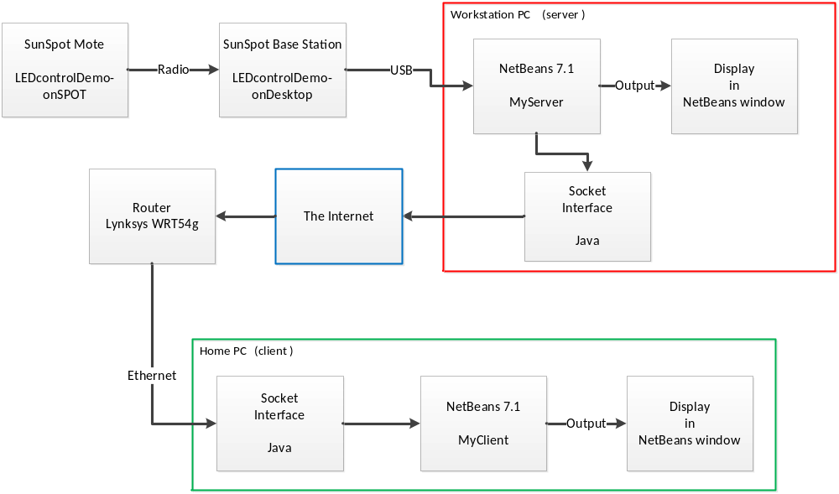
Architecture

Slide 3
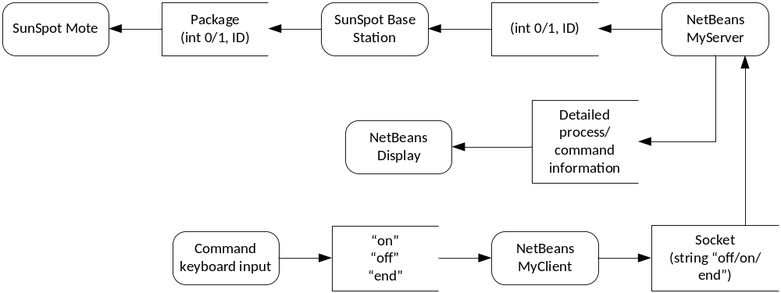
Data Flow

Slide 4
Demonstration of solution
See two laptop setup.

